Slide 1

Monitoring and Forecasting the COVID-19 Pandemic in Peru
Jacob Unterbrink*, Charles Nicholson, Talayeh Razzaghi, Andrés González, Yuber Velazco-Paredes, Brayan Alexander Lipe Huamani
IISE Annual Conference & Expo, May 20-23, 2023, New Orleans, LA

Slide 2
Background
Methodology
Results

Slide 3
Background
Peru has experienced the highest COVID-related fatality rate in the world.
Previous attempts to forecast cases and deaths in this region have proved challenging.
A deeper understanding of Peru propagation dynamics is crucial to improve the COVID landscape.
Project was completed as part of a research collaboration between the University of Oklahoma and Universidad Nacional de San Agustin de Arequipa.

Slide 4
Project Definition
The purpose of this project is to help quantify the COVID situation in Peru and Arequipa while laying a foundation for future work.
Specifically, this project:
Forecasts case and deaths patterns using epidemiological and time series methods.
Identifies inflection points among cases and deaths.
Analyzes auto- and cross-correlation.

Slide 5
Data
Region-level data collected from Peru government agencies.
Features include:
Cases
Deaths
Hospitalized individuals
Etc.
Period ranges from Marth 13th, 2020 through April 5th, 2022.
Relatively clean, missing data in ICU beds in use/available.

Slide 6
Background
Methodology
Results

Slide 7
Related Work
Data-driven models
Tend to excel in raw predictive power.
Agent-based simulations
Machine leaning methods
Epidemiological models
Allow for propagation mechanism to be modeled directly.
Compartmental framework
SIR model variations

Slide 8
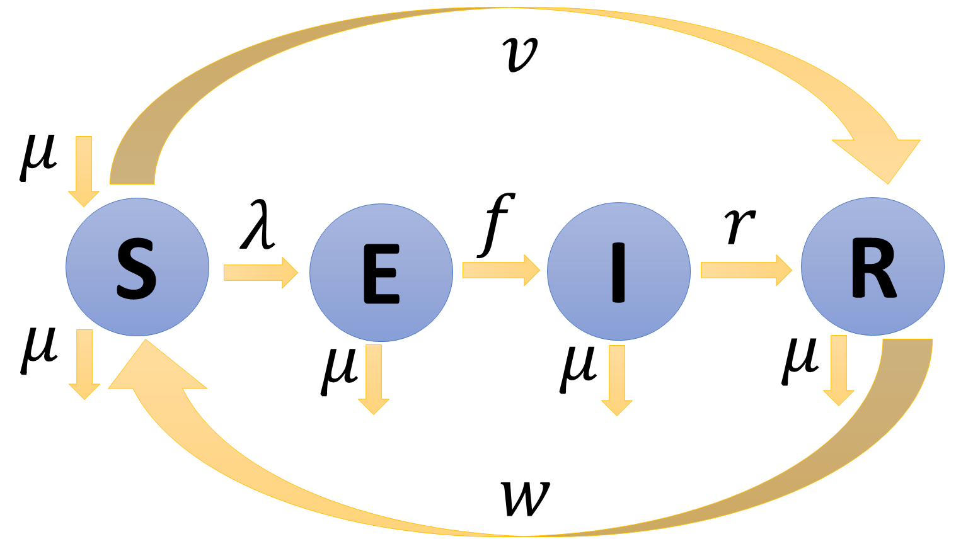
SEIR Compartmental Model
Splits population into one of four compartments:
Susceptible (S)
Exposed (E)
Infected (I)
Recovered (R)
Population moves between compartments based on various parameter values.
Figure 1: SEIR model framework.

Slide 9
Inflection Points
Seven-day rolling average was taken to smooth the curves.
Each day’s value was compared with the previous day.
If the value of new infection (deaths) changed by more than 25 (two) and the slope’s sign changed, the day was marked as an inflection.
Choice of 25 and two were subjective, but isolated most impactful changes.

Slide 10
Time Series Modeling
Allows for quantitative understanding of trends over time.
Autocorrelation measures similarity between two or more observations with a time lag.
Cross-correlation measures the movement of two or more time series relative to one another.
Understanding these trends can help future modeling efforts.

Slide 11
Background
Methodology
Results

Slide 12
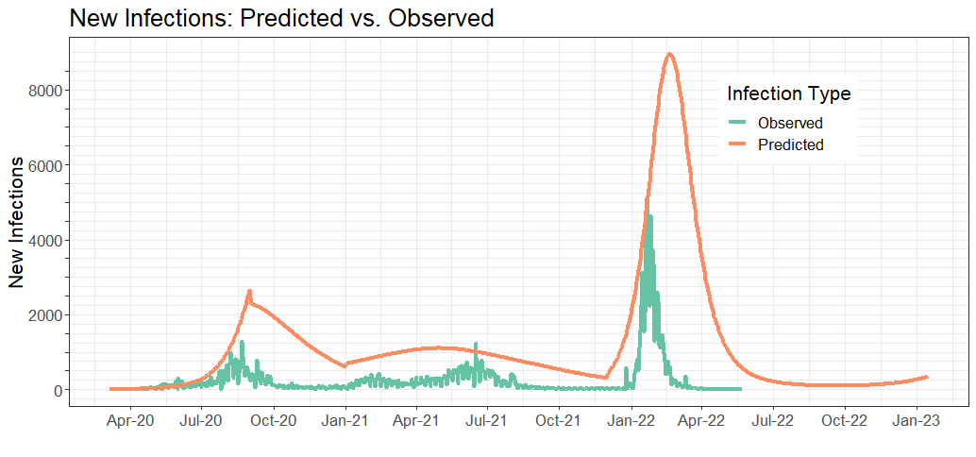
SEIR Compartmental Model (Cases)
Captures overall trend
Largest deviations:
Aug. through Dec. 2020
Jan. through June 2022
When predicted values trend up quickly, they struggle to come back down.
RMSE of 2,102.71
Figure 2: SEIR model output (cases).

Slide 13
SEIR Compartmental Model (Deaths)
Model did not fit deaths well.
Decent results early in the period.
Especially challenging between Apr. and Aug. 2021.
Likely issue with using a constant multiplier for deaths.
RMSE of 23.55

Slide 14
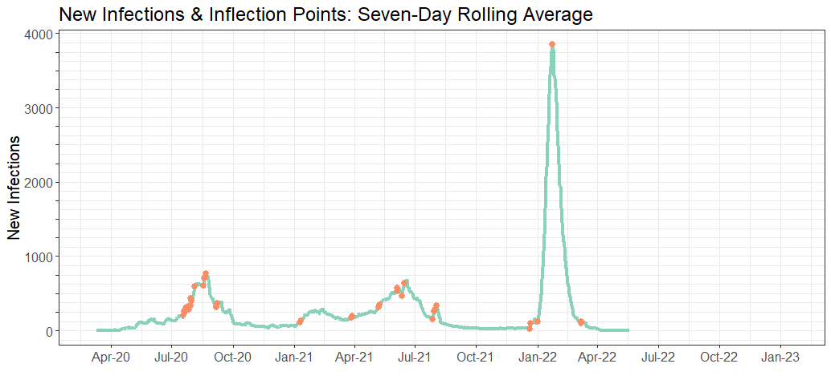
Inflection Points
New infections yielded 33 points.
Late July
Mid-June
Late December
New deaths yielded 20 points.
Late July
May
Late January
Figure 3: Inflection points (deaths).

Slide 15
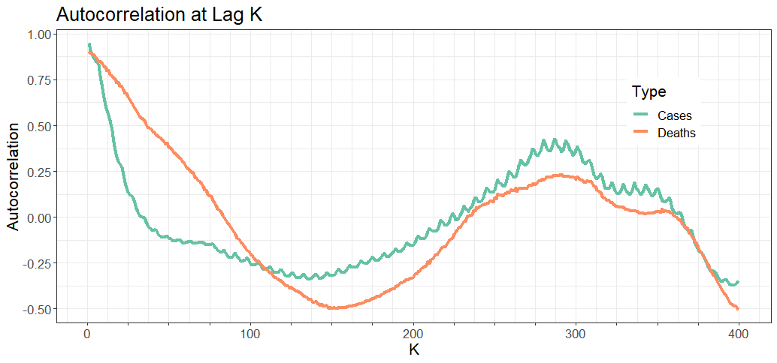
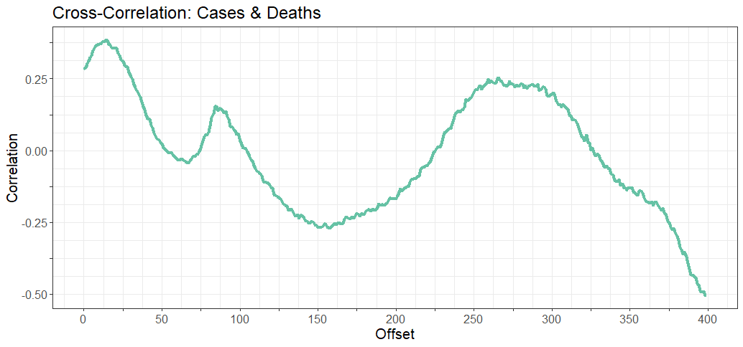
Time Series Analysis
Correlation exists among lags.
Both cases and deaths exhibit seasonality and trend.
Cross-correlation peaks at offset 14, implying a two-week lag between initial infection and death.
Figures 4 & 5: Auto- and cross-correlation.

Slide 16
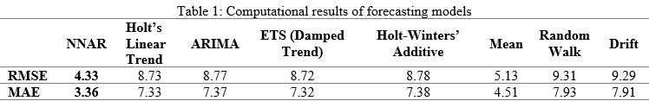
Time Series Forecasting
Eight approaches used.
Data prior to Mar. 15th, 2022, was used for training.
Mar. 16th, 2022, through Apr. 5th, 2022, was used for testing.
Best results fall under NNAR (4.33 RMSE, 3.36 MAE).

Slide 17
Conclusions & Future Work
Strong foundation provided for future work:
SEIR model was developed that captures overall trend.
Dates of inflection identified.
Time series methods were applied.
Moving forward:
More parameters accounted for/optimized under SEIR model.
Research into critical inflection points.
Research into outside factors that might trigger disease spread.
Relationship between cases, deaths, and hospitalizations needs to be understood further.

Slide 18


This work was funded by the Universidad Nacional de San Agustin (UNSA), Peru, through the University of Oklahoma’s IREES/LASI, and the Global Change and Human Health Institute.

